Slide 1
EXAM 1 Review

Slide 2
Definitions Are Important
 | TERM |  | Definition
A. | Experimental Unit | 1. | A SUBSET of the all the units of interest
B. | Statistical Inference | 2. | An estimate about our group of interest
C. | Population | 3. | The characteristic of interest
D. | Variable | 4. | ALL the units of interest
E. | Sample | 5. | The OBJECT from which we collect data

Slide 3
Definitions Are Important
Experimental Unit:
An OBJECT from which we collect data
Population:
The set of ALL the units
(people, things, etc.) that we are interested in studying
Sample:
A SUBSET of the units of a population
Variable:
The characteristic or property of interest (e.g. height, weight, price, etc.)
Statistical Inference:
An estimate, prediction, or generalization about a POPULATION,
based on information from a SAMPLE

Slide 4
TYPES OF DATA – be able to tell them apart
QUALITATIVE:
QUANTITATIVE:
Cannot be measured on a natural numerical scale
Can only classify the data points into ONE of a group of categories
Ordinal:
Data can be ranked in a meaningful way
Nominal:
The categories cannot be ranked in any meaningful way
Recorded on a naturally-occurring numerical scale
Interval:
The origin has no meaning.
Data can be added/subtracted, but cannot be multiplied or divided (e.g. temperature scale)
Ratio:
Origin (value 0) has meaning.
Data CAN be multiplied/divided
(e.g. length, weight, etc.)

Slide 5
Categorize the following:
Length in inches
Hair color
Spice level
IQ Score
Award color for competition
Size of house by category
Weight in ounces
Degrees Fahrenheit
Current mood
Score on class exam
Time in microseconds
Ice cream flavor preference

Slide 6
Categorize the following:
Length in inches (Quant, Ratio)
Spice level (Qual, Ord)
Ice cream flavor preference (Qual, Nom)
IQ Score (Quant, Interval)
Award color for competition
Size of house by category (Qual, Ord)
Weight in ounces (Quant, Ratio)
Degrees Fahrenheit (Quant, Interval)
Current mood (Qual, Ord)
Score on class exam (Quant, Ratio)
Time in microseconds (Quant, Ratio)
Hair color (Qual, Nom)

Slide 7
Sources of Data
Published Sources
List: newspapers, almanacs, historical records
2. Designed Experiments
List: controlled experiments, drug trials, double-blind study
3. Survey
List: poll, exit survey
Observational Study
List: field research where an effort is made not to affect the behaviors being observed

Slide 8
Bias
Need to have a _____representatice__________ & _____random____________ sample
Selection bias: Poor experimental design – a segment of the population has no chance of being selected
Non-response bias: Design was OK, but those refusing to participate do so in a non-random manner
Measurement error: Inherent in measuring technique, inevitable

Slide 9
More definitions: Qualitative data
Class:
DEFINED: category, grouping of interest
Class Frequency
DEFINED: the actual # of experimental units falling in a given class
Class Relative Frequency (a decimal between 0 and 1)
DEFINED: the class frequency / total # of units in the sample
Class Percentage(a % value between 0 and 100)
DEFINED: the relative frequency * 100

Slide 10
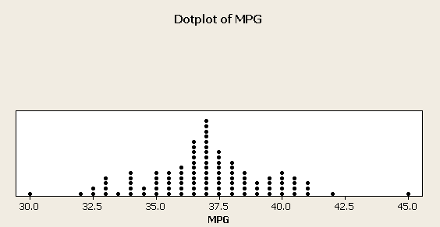
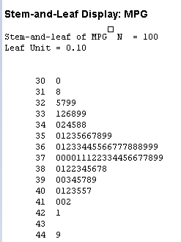
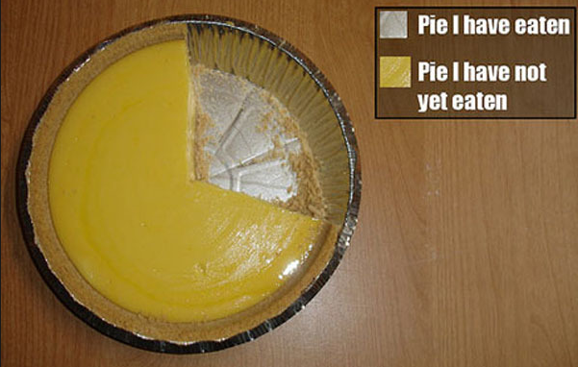
Bar Graph
Dot Plot
Represent Quantitative Data
Represent Qualitative Data
Pie Chart
Stem and Leaf

Slide 11
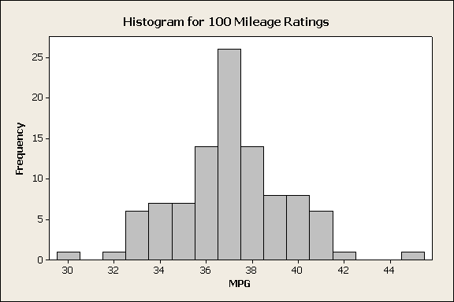
Histogram
Columns called “bins”
Good for large data sets
As number of units being represented increases:
Bin range: if range increase, may need to increase bin range as well
Bin width: As number of points increases, may need to “shrink” physical bin width
May end up with outer “edge” resembling a smoothly curved line

Slide 12
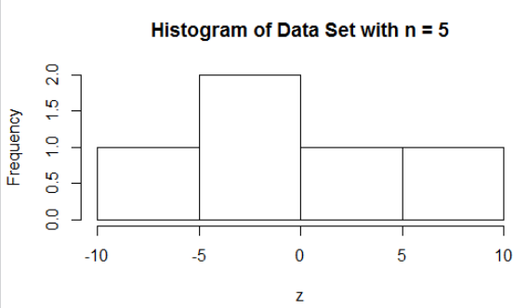
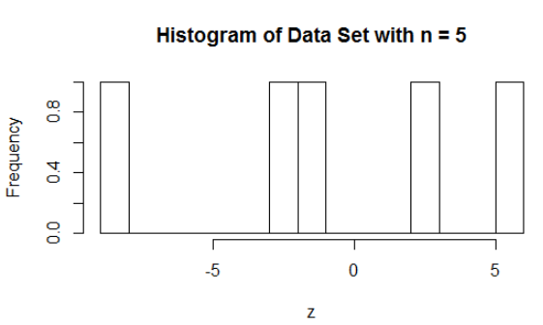
Histograms for Various Sample Sizes – trying different bin “widths” (i.e. changing # of bins)
All data sets were generated to be normally distributed with mean = 0 and std dev = 3
Same data set: Histogram 1 has 4 bins, histogram 2 has 10 bins (and looks very silly)

Slide 13
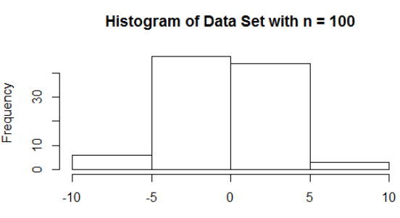
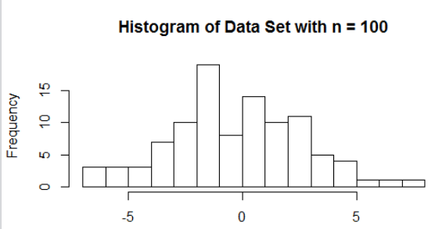
Likewise, NOT a good idea to have too FEW bins with a larger dataset
Same data set: Histogram 1 has 4 bins, histogram 2 has 15 bins (and looks much better)

Slide 14
Summary of a Data Set
Mean → average value
Median → middle value
Mode → most frequent value (may be MORE THAN ONE)
Skew → mean is closer to the tail, tail NAMES the skew
Range → largest - smallest
Variance → uses sum of squares
Standard Deviation → square root of variance

Slide 15
Five-Number Summary
min, max, median, lower quartile, upper quartile
Chebyshev’s Rule vs. Empirical Rule
Any data set
Possible for very FEW values to fall within 1 std. dev. of mean (e.g. bimodal dataset)
But in general, for k > 1, at least 1 – 1/k² of your data will fall within k std. dev. of mean
Normally distributed data
68.26 within 1 std. dev. of mean
95.44 within 2 std. dev. of mean
99.73 within 3 std. dev. of mean

Slide 16
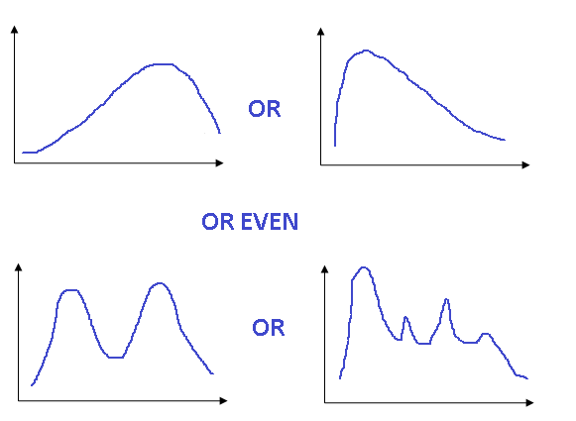








Chebyshev’s Rule
Applies to ANY data set:
It is possible for VERY FEW of the measurements to fall within ONE standard deviation of the mean.
At least of the measurements will fall within TWO standard deviations of the mean.
At least of the measurements will fall within THREE standard deviations of the mean.
In general, for any number k greater than 1, at least (1 – 1/k²) of the measurements will fall within k standard deviations of the mean.
Chebyshev’s Rule applies to both sample data sets and population data sets.
Within 1 standard deviation of the mean: sample, population
Within 2 standard deviations of the mean: sample, population
Within 3 standard deviations of the mean: sample, population

Slide 17
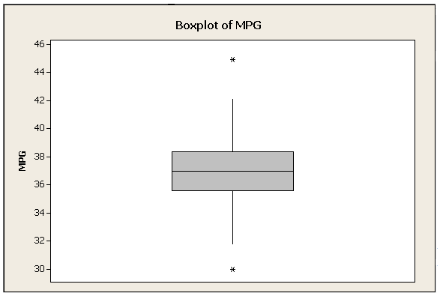
Detecting Outliers Using IQR and Boxplots:
Largest observation that is not outside the upper inner fence
OUTLIER
Upper Hinge (Q_{U})
MEDIAN
Lower Hinge (Q_{L})
Smallest observation that is not outside the lower inner fence
OUTLIER
The vertical lines extending from the box are called
“whiskers” and extend to the most extreme
measurements within the INNER FENCES
INNER FENCES: (Q_{L} – 1.5 IQR) and (Q_{U} + 1.5 IQR)
OUTER FENCES: (Q_{L} – 3 IQR) and (Q_{U} + 3 IQR)
Normal (or potential) outliers:
Fall BETWEEN the inner and outer fences.
Extreme outliers:
Fall OUTSIDE the outer fences.

Slide 18
Relative Standing: Percentile Ranking
Numerical Measures of Relative Standing: Percentile Ranking
Tells what percentage of the measurements are below a certain value and what percentage are above (i.e. where one measurement falls relative to all the others).
Practical only for LARGE data sets.
Find by:
Arranging any set of n measurements in ascending order.
Using the following equation:
p^{th} measurement = (percentile/100 ) (n + 1)
For example, to find the measurement in a 50-measurement data set that is at the 85% percentile:
.85 (51) = 43.35 ← ROUND this number to the nearest INTEGER, 43,
then COUNT to the 43rd measurement – whatever the value of that measurement is gives the 85th percentile for the data set

Slide 19
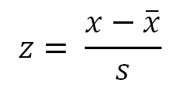
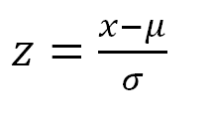
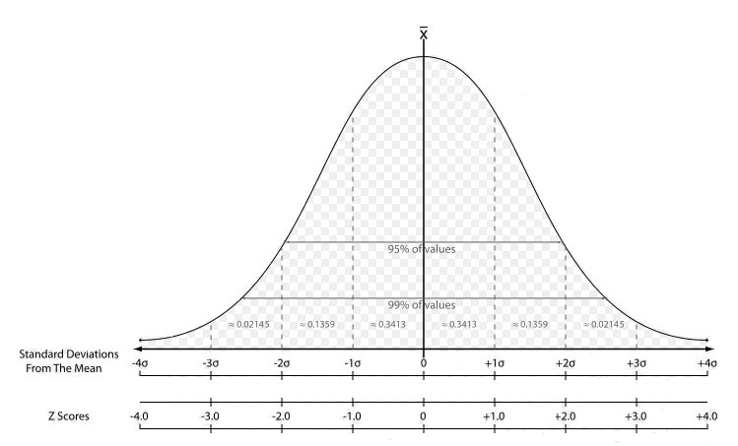
Relative Standing: z-score
z score:
(for a sample)
(for a population)
Normal (or potential) outliers:
2 < | z | < 3
Extreme outliers:
| z | > 3

Slide 20
Chapter 3
Contingency Table
Tree Diagram
Venn Diagram as EXTRA CREDIT

